Slide 1
Department of
Software Engineering
Project Title
Student name:
Supervisor:

Slide 2
Introduction
problem you are trying to solve
Support your introduction by doing any structure, interface, flowchart.

Slide 3
Project Objectives
What the project provides; Inputs, Outputs, Results:
......
......

Slide 4
Project Feasibility
Are the objectives achievable ? Or Expandable ?
Can it grow, specify !

Slide 5
Overall activities
For example;
  Developing a database system.
  Testing the system within requirements
  Applying (deploy) the system to work
  .......
  .......
  Report writing

Slide 6
Tasks
What are the tasks to do the activities
For example;
  Systematic approach to design the database ( ER Modelling or whatever)
  Analyzing the requirements
  Analyzing the system into small program pieces in order to do more efficient programming
  Testing the system
  .......
  .......

Slide 7
Resources
Internet
Books
Any Person
Software ( which utility you use ?)
Hardware ( PC, ......)
......

Slide 8
Risks
Do you have any risk on completing the project or progressing on the project, Mention it here

Slide 9
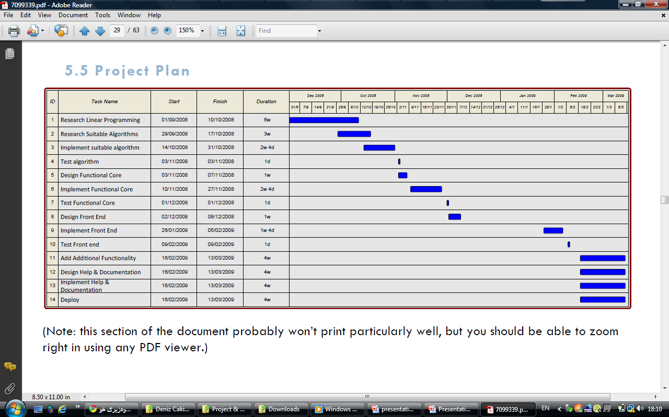
Project plan and schedule
For Example:

Slide 10
Conclusion
Specify for example:
  what the system will do and for whom
  Which: Tool/program/utility/protocols/functions/algorithms you use
  Any benefits ; business, community, organization.
  Any further concluded information you can provide.

Slide 11
Thank you
Any Question ?

